Slide 1
Agenda
Tuesday, the 11th, morning (3h)
General information on NoSQL database
Installation of what is required
Discover the cluster
Wednesday, the 12th, morning (3h)
Interacting with the cluster
Wednesday, the 12th, afternoon (3h)
Personal manipulation, use case.

Slide 2
Understanding NoSQL Databases
A Comprehensive Introduction
Notes:
Title: "Understanding NoSQL Databases: A Comprehensive Introduction"
Introduction to NoSQL Databases
Definition and emergence context.
Quick comparison with relational databases.
Differences from Relational Databases
Redefinition of ACID constraints.
Data storage structure (non-tabular).
Table Structure in NoSQL vs. Relational Databases
Examples of NoSQL data models (key-value, document, column, graph).
SQL vs. NoSQL Query Language
Differences in query languages.
Examples of NoSQL queries.
Handling Joins in NoSQL
How joins are handled differently or are absent.
Document-Type Databases (OpenSearch, MongoDB)
Specific relaxed constraints for these databases.
Advantages and use cases.
Graph-Type Databases (Neo4j)
Specific relaxed constraints for these databases.
Advantages and use cases.
Temporal Databases (InfluxDB)
Specific relaxed constraints for these databases.
Advantages and use cases.
Advantages of Using NoSQL Databases
Scalability, flexibility, performance.
Use Cases and Potential Applications of NoSQL Databases
Examples in various sectors (finance, social media, healthcare, etc.).

Slide 3
Introduction to NoSQL Databases
Définition
« Not Only SQL» Designed for high scalability and increased flexibility in handling various data types.
Context of Emergence
emerged in the 2000s
horizontal scalability
large volumes of diverse data and high traffic
Notes:
Definition of NoSQL Databases: NoSQL, standing for "Not Only SQL", refers to a category of database management systems that diverge from traditional relational databases by not primarily using SQL for data manipulation and querying. They are designed for high scalability and increased flexibility in handling various data types.
Context of Emergence: NoSQL databases emerged in the 2000s in response to the limitations of relational databases, particularly regarding horizontal scalability and efficient management of large volumes of diverse data and high traffic. They cater to the needs of modern applications such as social networks, big data, and real-time applications.
Quick Comparison with Relational Databases: Unlike relational databases that store data in structured tables and use fixed schemas, NoSQL databases allow for a dynamic schema for increased flexibility. They can store data in various formats: document, key-value, graph, or columns, making them ideal for applications requiring large amounts of unstructured data.
This content provides a solid foundation for understanding NoSQL databases and their positioning relative to traditional systems, essential for introducing the topic in a presentation.`
Horizontal scalability refers to the ability of a system to increase capacity by connecting multiple hardware or software entities so that they work as a single logical unit. When a system is horizontally scalable, adding more nodes (servers, for instance) to the system increases its capacity and performance, which is particularly useful in environments with high data volume or high traffic. This contrasts with vertical scalability, which involves adding more resources, such as CPU or memory, to a single node. Horizontal scalability is a key feature in many distributed systems, including NoSQL databases, allowing them to manage more data and handle more concurrent users effectively.

Slide 4
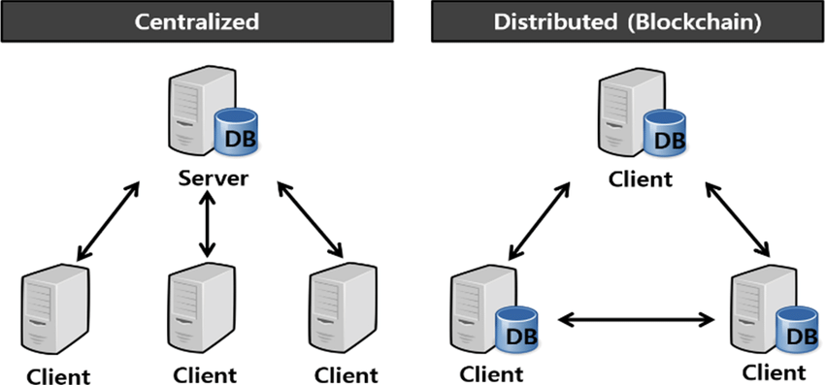
Centralized / Versus Distributed

Slide 5


Scalability
The scalability of an application is the measure of the number of client requests it can simultaneously handle
 | Vertical | Horizontal
Data | Data is executed on a single node | Data is partitioned and run on multiple nodes
Management | Easy to manage, share data reference | Complex task as there is no shared address space
Downtime | Downtime while upgrading the machine | No downtime
Upper limit | Limited by machine specifications | Not limited by machine specification
Cost | Lower license Higher material | Higher licence Lower Material

Slide 6
Redefinition of Databases
Redefinition of ACID Constraint to BASE
ACID
Atomicity
Consistency
Isolation
Durability
BASE
Basically Available
Soft State
Eventual Consistency
Greater flexibility and improved performance in distributed environments by somewhat sacrificing immediate consistency for availability and fault tolerance.
Notes:
Redefinition of ACID Constraints: Relational databases are known for their strict adherence to ACID (Atomicity, Consistency, Isolation, Durability) constraints, which ensure transaction reliability. NoSQL databases, on the other hand, often adopt a more flexible consistency model known as BASE (Basically Available, Soft state, Eventual consistency), allowing for improved performance and scalability by somewhat sacrificing immediate consistency.
Data Storage Structure: While relational databases use a tabular structure with fixed schemas, NoSQL databases allow for a variety of storage structures such as key-value, document, column, or graph. This flexibility better addresses the specific needs of modern applications that manage varied and often unstructured data.
This slide should help understand the main structural and conceptual differences between NoSQL and traditional relational systems, highlighting why and how NoSQL may be more suited to certain modern applications.`
Atomicity, Consistency, Isolation, and Durability (ACID) are fundamental properties that ensure reliable processing of database transactions. Here's a brief explanation of each:
Atomicity: This property ensures that each transaction is treated as a single, indivisible unit, which either completely succeeds or completely fails. If any part of the transaction fails, the entire transaction is rolled back, and the database state is left unchanged.
Consistency: Consistency ensures that a transaction can only bring the database from one valid state to another, maintaining all predefined rules, including integrity constraints. This means the database remains consistent before and after the transaction.
Isolation: Isolation ensures that transactions are securely and independently processed simultaneously without interference, despite the fact that multiple transactions might occur at the same time. This property prevents transactions from affecting each other, which could result in inconsistent data.
Durability: Durability guarantees that once a transaction has been committed, it will remain so, even in the event of a system failure. This means the changes made by the transaction are permanently stored in the database and can be recovered in the event of a system crash.
These properties are crucial for ensuring the reliability and robustness of database systems, particularly in systems that handle many transactions or critical data.`
BASE (Basically Available, Soft state, Evental consistency) est un modèle de cohérence utilisé dans les systèmes de gestion de bases de données, notamment dans les bases de données NoSQL. Voici une explication de chaque composant de BASE :
Basically Available : Ce principe indique que le système garantit la disponibilité en termes d'accès aux données (lecture et écriture) même en cas de pannes partielles. Cela signifie que le système est conçu pour être toujours opérationnel et accessible, bien que toutes les données ne soient pas toujours immédiatement cohérentes.
Soft state : Le "soft state" signifie que l'état du système peut changer avec le temps, même sans entrée externe. Cela est dû au fait que les systèmes utilisant le modèle BASE ne garantissent pas la cohérence immédiate des données à tout moment, permettant ainsi des états intermédiaires.
Eventual consistency : La cohérence finale est la promesse que, à condition qu'il n'y ait pas de nouvelles mises à jour sur les données, toutes les copies des données finiront par devenir cohérentes. En d'autres termes, si le système est laissé sans modifications pendant un certain temps, toutes les répliques des données se synchroniseront.
Le modèle BASE est souvent opposé au modèle ACID des bases de données relationnelles, qui met l'accent sur la cohérence immédiate et stricte. BASE, en revanche, permet une plus grande flexibilité et une meilleure performance dans les environnements distribués en sacrifiant quelque peu la cohérence immédiate pour la disponibilité et la tolérance aux pannes.`

Slide 7
SQL vs. NoSQL Query Language
SQL (Structured Query Language) in Traditional Databases
Complex querying
Data Integrity
Scalability and Flexibility
Standardization
Security
Why NoSQL Databases Do Not Always Use SQL
Schema-less Data
Scalability concerns
Different Data Access Patterns
Performance optimization
Notes:
SQL is a powerful tool for managing and manipulating structured data in relational databases. Here are some key aspects that highlight its strength:
Complex Querying: SQL allows for complex querying operations such as joins, unions, and subqueries, enabling users to retrieve and manipulate data from multiple tables based on specific conditions.
Data Integrity: SQL supports transaction control commands like COMMIT and ROLLBACK, coupled with constraints such as primary keys and foreign keys, which help maintain data accuracy and integrity.
Scalability and Flexibility: While SQL databases are schema-based and require predefined data structures, they are highly optimized for handling large volumes of data and complex queries, making them scalable and efficient in resource management.
Standardization: SQL is a standardized language that is widely used and supported across different database systems, ensuring that skills and knowledge are transferable among various platforms and applications.
Security: SQL provides robust data security features, including permissions and access controls, which help protect sensitive data from unauthorized access and manipulation.
These capabilities make SQL indispensable for applications that require reliable data management, complex querying, and high levels of data integrity.`
Why NoSQL Databases Do Not Always Use SQL:
NoSQL databases are designed to handle a wide variety of data types and structures, which often do not conform to the rigid schema required by SQL. Here are some reasons why SQL is not always used in NoSQL environments:
Schema-less Data: NoSQL databases often store data in formats that are flexible and schema-less, such as JSON documents, key-value pairs, or graphs. This flexibility allows for the storage of unstructured or semi-structured data, which does not fit neatly into the table-and-row format required by SQL.
Scalability Concerns: NoSQL databases are built to scale horizontally, meaning they are designed to spread data across many servers. SQL, with its complex queries and transactional guarantees, can become a bottleneck in such distributed environments, limiting the scalability benefits of NoSQL.
Different Data Access Patterns: NoSQL databases often cater to specific data access patterns, such as key-value lookups, graph traversals, or wide-column storage, which do not require the full capabilities of SQL. Instead, simpler, more direct forms of querying are often more efficient and sufficient for these patterns.
Performance Optimization: SQL queries can be resource-intensive, especially when dealing with large volumes of data. NoSQL databases often use more straightforward query languages or APIs that are optimized for performance and the specific type of data they handle.
Development Simplicity: Using SQL requires understanding and implementing relational database principles, which can add complexity to development. NoSQL databases aim to provide simpler, more direct interactions with data, which can speed up development in certain applications.
These factors contribute to the decision to use alternative querying languages or APIs in NoSQL systems, tailored to the specific needs and characteristics of the data and the database architecture.`

Slide 8
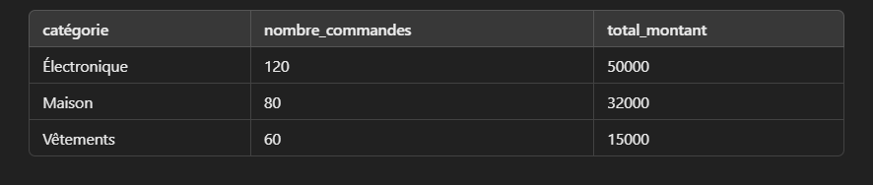
Requête SQL
Database with two tables
Clients (id_client, nom, email)
Commandes (id_commande, id_client, montant, date_commande)
SELECT p.categorie, COUNT(c.id_commande) AS nombre_commandes, SUM(c.montant) AS total_montant
FROM Commandes c
JOIN Produits p ON c.id_commande = p.id_commande
WHERE c.status = 'livré'
AND c.date_commande BETWEEN '2024-01-01' AND '2024-12-31'
GROUP BY p.categorie
ORDER BY total_montant DESC;
Join (JOIN Products p ON c.order_id = p.order_id)
Retrieves product categories associated with orders.
Filtering (WHERE c.status = 'delivered' AND order_date BETWEEN '2024-01-01' AND '2024-12-31’)
Selects only orders from 2024 that have been delivered.
Aggregation (GROUP BY p.categorie)Groups orders by product category.Count (COUNT(c.id_commande) AS nombre_commandes)
Returns the number of orders per category.
Sum (SUM(c.amount) AS total_amount)
Calculates total sales by category.
Sort (ORDER BY total_amount DESC)
Sort results from highest to lowest total amount.Translated with DeepL.com (free version)

Slide 9

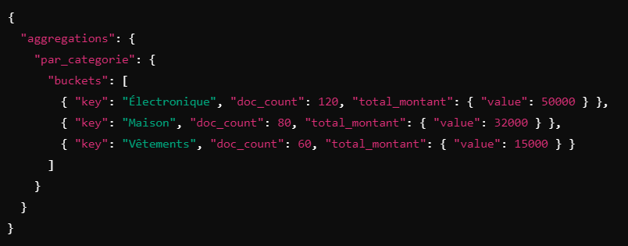
Requête NoSQL
{
"size": 0,
"query": {
"bool": {
"filter": [
{ "term": { "status": "livré" } },
{ "range": { "date_commande": { "gte": "2024-01-01", "lte": "2024-12-31" } } }
]
}
},
"aggs": {
"par_categorie": {
"terms": {
"field": "produits.categorie.keyword",
"size": 10
},
"aggs": {
"total_montant": {
"sum": {
"field": "montant"
}
}
}
}
}
}

Slide 10

Differences from Relational Databases
Data Storage Structure
Relational databases use a tabular structure with fixed schemas
NoSQL databases allow for a variety of storage structures
Key/Value
Columns
Graph
Documents
Notes:
Redefinition of ACID Constraints: Relational databases are known for their strict adherence to ACID (Atomicity, Consistency, Isolation, Durability) constraints, which ensure transaction reliability. NoSQL databases, on the other hand, often adopt a more flexible consistency model known as BASE (Basically Available, Soft state, Eventual consistency), allowing for improved performance and scalability by somewhat sacrificing immediate consistency.
Data Storage Structure: While relational databases use a tabular structure with fixed schemas, NoSQL databases allow for a variety of storage structures such as key-value, document, column, or graph. This flexibility better addresses the specific needs of modern applications that manage varied and often unstructured data.
This slide should help understand the main structural and conceptual differences between NoSQL and traditional relational systems, highlighting why and how NoSQL may be more suited to certain modern applications.`
Atomicity, Consistency, Isolation, and Durability (ACID) are fundamental properties that ensure reliable processing of database transactions. Here's a brief explanation of each:
Atomicity: This property ensures that each transaction is treated as a single, indivisible unit, which either completely succeeds or completely fails. If any part of the transaction fails, the entire transaction is rolled back, and the database state is left unchanged.
Consistency: Consistency ensures that a transaction can only bring the database from one valid state to another, maintaining all predefined rules, including integrity constraints. This means the database remains consistent before and after the transaction.
Isolation: Isolation ensures that transactions are securely and independently processed simultaneously without interference, despite the fact that multiple transactions might occur at the same time. This property prevents transactions from affecting each other, which could result in inconsistent data.
Durability: Durability guarantees that once a transaction has been committed, it will remain so, even in the event of a system failure. This means the changes made by the transaction are permanently stored in the database and can be recovered in the event of a system crash.
These properties are crucial for ensuring the reliability and robustness of database systems, particularly in systems that handle many transactions or critical data.`
BASE (Basically Available, Soft state, Evental consistency) est un modèle de cohérence utilisé dans les systèmes de gestion de bases de données, notamment dans les bases de données NoSQL. Voici une explication de chaque composant de BASE :
Basically Available : Ce principe indique que le système garantit la disponibilité en termes d'accès aux données (lecture et écriture) même en cas de pannes partielles. Cela signifie que le système est conçu pour être toujours opérationnel et accessible, bien que toutes les données ne soient pas toujours immédiatement cohérentes.
Soft state : Le "soft state" signifie que l'état du système peut changer avec le temps, même sans entrée externe. Cela est dû au fait que les systèmes utilisant le modèle BASE ne garantissent pas la cohérence immédiate des données à tout moment, permettant ainsi des états intermédiaires.
Eventual consistency : La cohérence finale est la promesse que, à condition qu'il n'y ait pas de nouvelles mises à jour sur les données, toutes les copies des données finiront par devenir cohérentes. En d'autres termes, si le système est laissé sans modifications pendant un certain temps, toutes les répliques des données se synchroniseront.
Le modèle BASE est souvent opposé au modèle ACID des bases de données relationnelles, qui met l'accent sur la cohérence immédiate et stricte. BASE, en revanche, permet une plus grande flexibilité et une meilleure performance dans les environnements distribués en sacrifiant quelque peu la cohérence immédiate pour la disponibilité et la tolérance aux pannes.`

Slide 11
Database Structure : Traditionnal
Relational databases use a structured data storage model organized into tables. Each table is defined by a schema that prescribes the structure and constraints of the data:
Tables: Each table represents a type of entity (like customers, orders, etc)
Schemas: The schema of a relational database defines the columns of each table Schemas are fixed.
Constraints: Relational databases enforce data integrity through constraints such as primary keys, foreign keys, and unique constraints.
Notes:
This structured approach allows for complex queries and transactions that maintain data integrity and consistency, making relational databases ideal for applications requiring robust data management and precise query capabilities.`
Tables: Which are akin to spreadsheets. Each table represents a type of entity (like customers, orders, etc.), and each row in the table represents a record or instance of that entity.
Schemas: The schema of a relational database defines the columns of each table, the type of data each column can hold (such as integer, text, date), and the relationships between tables. Schemas are fixed, meaning that the structure of the data must be defined before data can be stored and requires modifications to the schema if the structure needs to change.
Constraints: Relational databases enforce data integrity through constraints such as primary keys, foreign keys, and unique constraints. These ensure accuracy and consistency of data across multiple tables and prevent duplicate and erroneous data entries.

Slide 12
Database Structure : NoSQL
Key-Value Stores: These are the simplest form of NoSQL databases, designed for storing data as a collection of key-value pairs. They are highly efficient for scenarios where quick access to data is required, such as in caching and session storage, where the key is known.
Column Stores: Columnar databases store data in columns rather than rows, making them ideal for analytics and data warehousing scenarios where operations are typically performed on column data. This structure allows for efficient data compression and fast aggregation.
Graph Databases: These databases are optimized for storing and querying data that is interconnected, making them suitable for social networks, recommendation engines, and fraud detection systems where relationships between data points are crucial.
Document Stores: Document-oriented databases store data in document formats like JSON, XML, etc. They are versatile and flexible, making them suitable for content management systems and e-commerce applications where each document can be unique and evolve over time.
Notes:
This structured approach allows for complex queries and transactions that maintain data integrity and consistency, making relational databases ideal for applications requiring robust data management and precise query capabilities.`

Slide 13
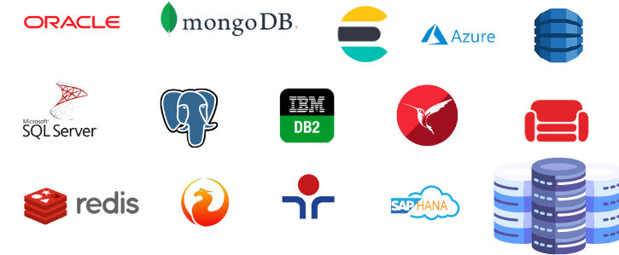

How to choose the correct database ?

Slide 14
Key-Value Databases (Redis)
What is a Key-Value Database?
- A NoSQL database storing data as key-value pairs
- Highly optimized for fast lookups using keys
- Data structures: strings, lists, sets, hashes
Why Use Redis?
✔ Ultra-fast in-memory storage (low-latency operations)
✔ Supports caching, pub/sub, and session storage
✔ Can persist data with snapshotting & AOF logs
✔ Scales horizontally using clustering
When Not to Use Redis?
❌ Complex queries & relationships needed (Use relational/graph DB)
❌ Large datasets exceeding RAM capacity
Notes:
AOF (Append-Only File) logs are a persistence mechanism in Redis that logs every write operation in a sequential file. This allows Redis to replay operations after a restart to reconstruct the database state.

Slide 15
Graph Databases (Neo4j)
What is a Graph Database?
- A database designed for relationships between data
- Stores data as nodes (entities) and edges (relationships)
- Uses graph traversal algorithms for queries
Why Use Neo4j?
✔ Perfect for connected data (e.g., social networks, fraud detection)
✔ Fast relationship-based queries
✔ Uses Cypher Query Language (CQL) for intuitive graph operations
✔ Supports deep link analysis
When Not to Use Neo4j?
❌ Flat/tabular data structure needed (Use SQL/NoSQL DB)
❌ Heavy transactional workloads with strict ACID compliance

Slide 16
Time-Series Databases (InfluxDB)
What is a Time-Series Database?
- A database optimized for storing & querying time-stamped data
- Handles high-ingestion rates efficiently
- Stores metrics, events, logs, and monitoring data
Why Use InfluxDB?
✔ Optimized for time-based queries
✔ Supports real-time analytics & monitoring
✔ Efficient data compression & retention policies
✔ SQL-like query language (InfluxQL, Flux)
When Not to Use InfluxDB?
❌ Relational data models needed (Use SQL DB)
❌ Transactional consistency required

Slide 17
Document Database : OpenSearch
Most popular document database : MongoDB
OpenSearch is related somehow to ElasticSearch
Introduction to Opensearch
Open-source search and analytics engine
Forked from Elasticsearch 7.10 after Elastic changed its license
Maintained by AWS and a growing open-source community
Used for full-text search, log analytics, and observability

Slide 18
Focus on Opensearch

Slide 19
History & Origin
2004: Elasticsearch was created as a distributed search engine based on Apache Lucene
2021: Elastic changed its license from Apache 2.0 to SSPL (Server Side Public License)
2021: AWS forked Elasticsearch 7.10, creating OpenSearch to keep it open-source
Present: OpenSearch continues to be developed independently with its own features and governance

Slide 20
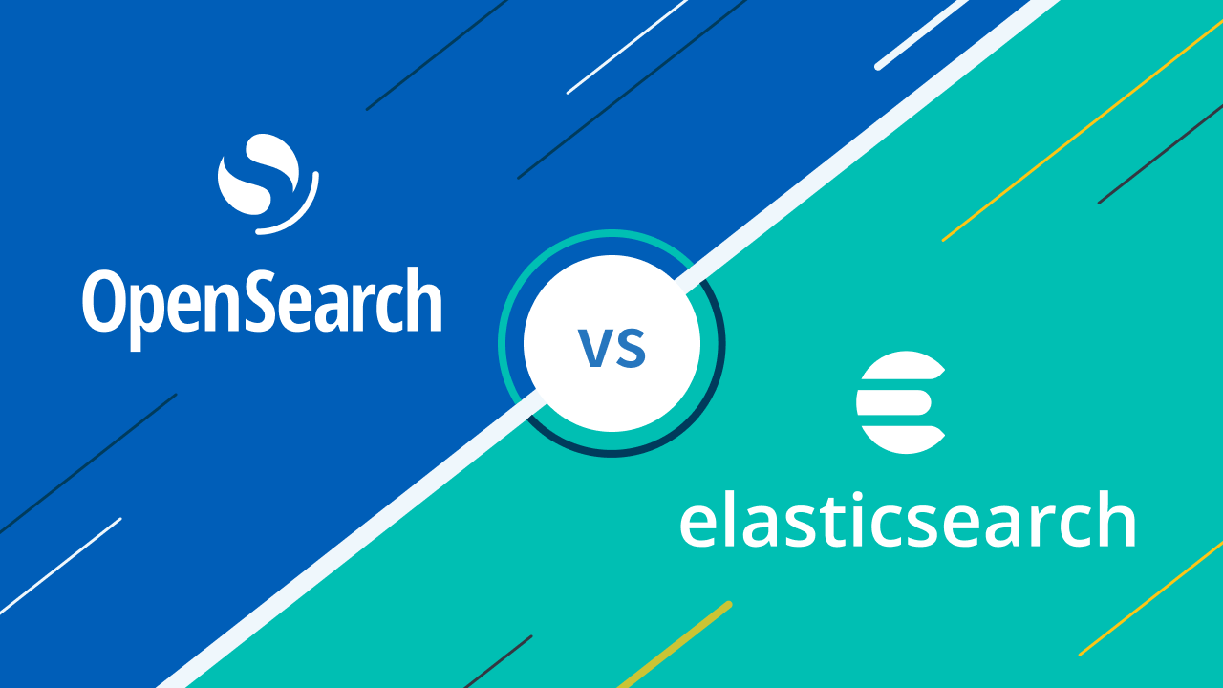
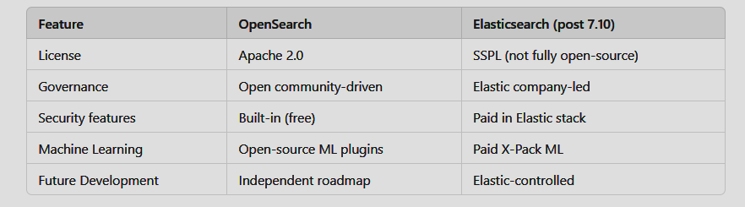
Key Differences Between OpenSearch & Elasticsearch

Slide 21
OpenSearch Roadmap
Scalability improvements: More efficient indexing and search performance
Better observability: Native support for logs, traces, and metrics
Security enhancements: Role-based access control, authentication integrations
Machine Learning & AI: Expanded ML capabilities for anomaly detection
Kibana replacement: OpenSearch Dashboards evolving with better visualization tools

Slide 22
When and Where to Use OpenSearch
Best Use Cases
✔ Log & Event Analytics
- Centralized logging (ELK alternative)
- Security monitoring (SIEM)
- Infrastructure observability
✔ Full-Text Search
- E-commerce product search
- Website & application search engines
- Document indexing and retrieval
✔ Monitoring & Observability
- Metrics, traces, and logs analysis
- Performance monitoring (APM replacement)
✔ Business Intelligence & Data Exploration
- Real-time dashboards and analytics
- Large-scale data visualization
When Not to Use OpenSearch?
❌ Strong ACID Compliance Needed → Use relational databases (e.g., PostgreSQL, MySQL)
❌ Transactional Workloads → Not optimized for OLTP operations
❌ Graph Database Needs → Use Neo4j or AWS Neptune

Slide 23
Opensearch Platform

Slide 24
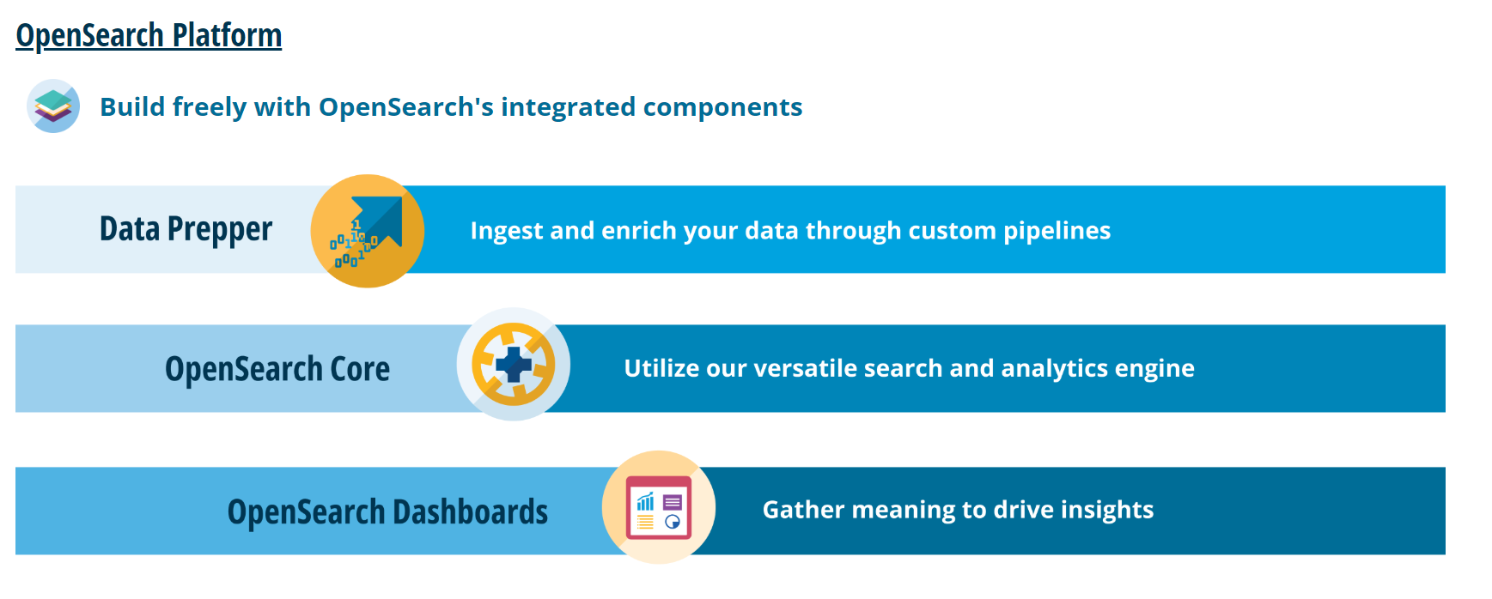
Opensearch Platform

Slide 25
What is a document
Data is stored as a document, as a json object with a unique Id
{
"_id": 2,
"name": "Jane Smith",
"email": "jane.smith@example.com",
"age": 25
}

Slide 26
Index
Documents that are related to each others are grouped into index
Index : products
Index : users
{
"_id": 1,
"name": “Smartphone",
“price": 800,
“brand": “XYZ Tech
}
{
"_id": 2,
"name": “Camera",
“price": 500
“brand": “CameroCo”
}
{
"_id": 2,
"name": "Jane Smith",
"email": "jane.smith@example.com",
"age": 25
}
{
"_id": 3,
"name": “Tom Durand",
"email": “tom.durand@example.com",
"age": 42
}

Slide 27
Opensearch Cluster
Opensearch Cluster
Node 1
products
Shard 1
users
Shard 1
Shard 1

Slide 28

OpenSearch Cluster
OpenSearch Cluster
Node 1
There is not enough space on my node for all my data
products
Shard 1
users
Shard 1
Shard 1

Slide 29
OpenSearch Cluster
OpenSearch Cluster
Node 1
Node 2
Node 3
products
Shard 1
Shard 2
Shard 3
users
Shard 2
Shard 3
Shard 1
Shard 2
Shard 1

Slide 30
OpenSearch Cluster
OpenSearch Cluster
Nœud 1
Nœud 2
Nœud 3
I want to be sure that my data is safe even if i lose a node
products
Shard 1
Shard 2
Shard 3
users
Shard 2
Shard 3
Shard 1
Shard 2
Shard 1

Slide 31
OpenSearch Cluster
products
OpenSearch Cluster
Node 1
Node 2
Node 3
Node 4
Node 5
Node 6
Shard 1
Shard 2
Shard 3
Replica 1
Replica 2
Replica 3
Shard 2
Replica 3
Shard 1
Shard 3
Replica 1
Replica 2
Shard 2
Shard 1
Replica 1
Replica 2
users

Slide 32
OpenSearch Cluster
OpenSearch Cluster
Node 1
Node 2
Node 3
Node 4
Node 5
Node 6
Shard 1
Shard 2
Shard 3
Replica 1
Replica 2
Replica 3
Shard 2
Replica 3
Shard 1
Shard 3
Replica 1
Replica 2
Shard 2
Shard 1
Replica 1
Replica 2
{
"_id": 2,
"name": "Jane Smith",
"email": "jane.smith@example.com",
"age": 25
}
{
"_id": 3,
"name": “Tom Durand",
"email": “tom.durand@example.com",
"age": 42
}

Slide 33
Opensearch Cluster
OpenSearch operates as a distributed system, and its primary components include nodes, shards, and replicas.
Nodes: Individual instances of OpenSearch that make up the cluster.
Shards: Divisions of data within an index that allow for parallelism and scalability.
Replicas: Duplicate copies of primary shards to ensure data availability and fault tolerance.

Slide 34
Interact With the Cluster
CRUD operations
Filters and Queries
Mapping
Full Text Queries
Geospatial Data
https://github.com/codingexplained/complete-guide-to-elasticsearch/tree/master

Slide 35
CRUD operations
C – Create
Create an index
Syntax:
PUT Name-of-the-Index
Example:
PUT favorite_candy

Slide 36
CRUD operations
C – Create
Index a document
When indexing a document, both HTTP verbs POST or PUT can be used.Use POST when you want Opensearch to autogenerate an id for your document.
Example:
POST favorite_candy/_doc
{
"first_name": "Lisa",
"candy": "Sour Skittles"
}
Syntax:
POST Name-of-the-Index/_doc
{
"field": "value"
}

Slide 37
CRUD operations
C – Create
Index a document
Use PUT when you want to assign a specific id to your document (i.e. if your document has a natural identifier - purchase order number, patient id, & etc).
Example:
PUT favorite_candy/_doc/1
{
"first_name": "John",
"candy": "Starburst"
}
Syntax:
PUT Name-of-the-Index/_doc/your-id
{
"field": "value"
}

Slide 38
CRUD operations
R - READ
Read a document
Syntax:
GET Name-of-the-Index/_doc/id
Example:
GET favorite_candy/_doc/1

Slide 39
CRUD operations
U - UPDATE
Update a document
Syntax:
POST Name-of-the-Index/_update/id
{
"doc": {
"field1": "value",
"field2": "value",
}
}
Example:
POST favorite_candy/_update/1
{
"doc": {
"candy": "M&M's"
}
}

Slide 40
CRUD operations
D - DELETE
Delete a document
Syntax:
DELETE Name-of-the-Index/_doc/id
Example:
DELETE favorite_candy/_doc/1

Slide 41
CRUD operations
C – Create
Index a document
When you index a document using an id that already exists, the existing document is overwritten by the new document. If you do not want a existing document to be overwritten, you can use the _create endpoint!
With the _create Endpoint, no indexing will occur and you will get a 409 error message.
Syntax:
PUT Name-of-the-Index/_create/your-id
{
"field": "value"
}
Example:
PUT favorite_candy/_create/1
{
"first_name": "John",
"candy": "Starburst"
}

Slide 42

Queries

Slide 43
Queries
The query DSL is a flexible, expressive search language that Opensearch uses to expose most of the power of Lucene through a simple JSON interface.
Syntax:
GET name-of-the-Index/_search
{
"query": YOUR_QUERY_HERE
}

Slide 44
Query structures
A query clause typically has this structure:
If it references one particular field, it has this structure:
{
QUERY_NAME: {
ARGUMENT: VALUE,
ARGUMENT: VALUE,...
}
}
Example:
GET favorite_candy/_search
{
"query": {
"match": {
“candy": “M&M’s"
}
}
}
{
QUERY_NAME: {
FIELD_NAME:
ARGUMENT: VALUE,
ARGUMENT: VALUE,..
}.
}
}

Slide 45
Create complex queries
Query clauses are simple building blocks that can be combined with each other to create complex queries.
Leaf clauses (like the match clause) that are used to compare a field to a query string.
Compound clauses that are used to combine other query clauses. For instance, a bool clause allows you to combine other clauses that either must match, must_not match, or should match if possible:

Slide 46
Example:
GET favorite_candy/_search
{
"bool": {
"must": { "match": { “candy": “M&M’s" }},
"must_not": { ”match”: { “first_name": "mary" }},
}
}
Compound clause can combine any other query clauses,
including other compound clauses. This means that compound clauses can be nested within each other, allowing the expression of very complex logic.

Slide 47
Query vs Filter
Filter asks a yes|no question of every document and is used for fields that contain exact values.
A query is similar to a filter, but also asks the question: How well does this document match?
A query calculates how relevant each document is to the query, and assigns it a relevance _score, which is later used to sort matching documents by relevance. This concept of relevance is well suited to full-text search, where there is seldom a completely “correct” answer.
As a general rule, use query clauses for full-text search or for any condition that
should affect the relevance score, and use filter clauses for everything else.

Slide 48
Most common queries and filters
term Filter
The term filter is used to filter by exact values, be they numbers, dates, Booleans, or not_analyzed exact-value string fields:
{
{ "term": { "age": 26 }}
{ "term": { "date": "2014-09-01" }}
{ "term": { "public": true }}
{ "term": { "tag": "full_text" }}
}

Slide 49
Most common queries and filters
terms Filter
The terms filter is the same as the term filter, but allows you to specify multiple values to match. If the field contains any of the specified values, the document matches:
{
"terms": { "tag": [ "search", "full_text", "nosql" ] }
}

Slide 50
Most common queries and filters
range Filter
The range filter allows you to find numbers or dates that fall into a specified range:
The operators that it accepts are as follows:
gt : Greater than
gte : Greater than or equal to
lt : Less than
lte : Less than or equal to
{
"range": {
"age": {
"gte": 20,
"lt": 30
}
}
}

Slide 51
Most common queries and filters
exists and missing Filters
The exists and missing filters are used to find documents in which the specified field either has one or more values (exists) or doesn’t have any values (missing)
{
"exists": {
"field": "title"
}
}

Slide 52
Most common queries and filters
Bool Filters
The bool filter is used to combine multiple filter clauses using Boolean logic. It accepts three parameters:
must : These clauses must match, like and.
must_not : These clauses must not match, like not.
should : At least one of these clauses must match, like or.

Slide 53
Search for information
There are two main ways to search in Opensearch:
Queries : to retrieve documents that match the criteria.
Aggregations : to summarizes your data as metrics, statistics, and other analytics.

Slide 54
Queries
Syntax:
GET name_of_the_index/_search
{
"query": {
"Specify the type of query here": {
"Enter name of the field here": {
"gte": "Enter lowest value of the range here",
"lte": "Enter highest value of the range here"
}
}
}
}
Example:
GET favorite_candy/_search
Opensearch displays a number of hits and a sample of 10 search results by default.

Slide 55
Index mappings

Slide 56
Mapping
Mapping is the process of defining the fields/structure that documents follow and how they are stored and indexed on ES.
Mapping is generally used to define :
which string fields should be treated as full text fields
Which fields contain numbers, dates or geolocation
Whether the values of all fields in the document should be indexed in the _all field
Date format
Etc.
Each field has a data type, which can be :
A simple data type such as string, date, long, double, boolean or ip.
A type that supports the hierarchical nature of JSON, such as object or nested.
A special type such as geo_point, geo_shape or completion.

Slide 57
Mapping
Create a new index with a mapping :
Create a mapping on an existing index :
PUT /my_index?pretty
{
"settings": {
"number_of_shards": 1
},
"mappings": {
"properties": {
"name": {
"type": "text"
},
"age": {
"type": "integer"
}
}
}
}
PUT /my_index/_mapping?pretty
{
"properties": {
"email": {
"type": "keyword"
}
}
}
Retrieve the mapping :
Curl -XGET localhost:9200/my_index/_mapping
Notes:
https://www.elastic.co/guide/en/elasticsearch/guide/current/nested-mapping.html

Slide 58
Full text queries

Slide 59
Information Retrieval
Information Retrieval (IR) is the process of finding documents in a large documents with little or no structure, in a large collection, according to an information need.
IR develops models for :
interpret documents and needs, and bring them together
calculate answers quickly, even in the presence of very large collections
search engine" systems providing sophisticated, ready-to-use solutions.
Applications
Web search, used daily by billions of users
Searching messages in your mailbox
Searching for files on your computer
Searching for sources in a public or private document database
etc.

Slide 60
Lemmatization & Stemming
Lemmatization
Transforms a word into a canonical form (lemma) by standardizing gender (masculine or feminine), number (one or more), person (me, you, them...), mode (indicative, imperative...).
seeks → seek
dogs → dog
Stemming
Transforms a word into a radical or root. The affixes (suffixes, prefixes, postfixes, antefixes) are removed, leaving only the root.
Sometimes same result as the lemmatization:
fishing, fished, fish, fisher → fish
Source of error sometimes: university, universe → univers

Slide 61
How to represent a document?
TF-IDF
One-hot vector encoding
doc2vec
Bag of Words
skip-though vectors
Transformers
word2vec

Slide 62
Opensearch for geospatial data

Slide 63
Geospatial data representation
To represent geospatial data in Opensearch, you have two data types:
“geo_point”
“geo_shape”
In OpenSearch, the geo_distance function is based on the great-circle distance, which is calculated using the Earth's reference sphere. This distance is determined using Haversine's formula or other spherical approximations.

Slide 64
Geo Point
geo_point
fields accept latitude-longitude pairs, which can be used:
to find geo-points within a bounding box, within a certain distance of a central point, or within a polygon.
to aggregate documents geographically or by distance from a central point.
to integrate distance into a document’s relevance score.
to sort documents by distance.

Slide 65
Geo shape
geo_shape
With this data type you can have more representation geospacial data :
Point: defined by an one point with latitude and longitude.
Linestring: defined by an array of two or more positions.
Polygon: defined by a list of a list of points.
Multipoint: a list of geojson points.
Multilinestring: is an example of a list of geojson linestrings.
Multipolygon: list of geojson polygons.
Geometrycollection: collection of geojson geometry objects.
Envelope: consists of coordinates for upper left and lower right points of the shape to represent a bounding rectangle in the format [[minLon, maxLat], [maxLon, minLat]] .
Circle: consists of a center point with a radius.

Slide 66
Geospatial queries
You can search by:
geo_bounding_box: query to finds documents with geo-points that fall into the specified rectangle.
geo_distance: query to finds documents with geo-points within the specified distance of a central point.
geo_polygon: query to find documents with geo-points within the specified polygon.
geo_shape query: to finds documents with geo-shapes which either intersect, are contained by, or do not intersect with the specified geo-shape.

Slide 67
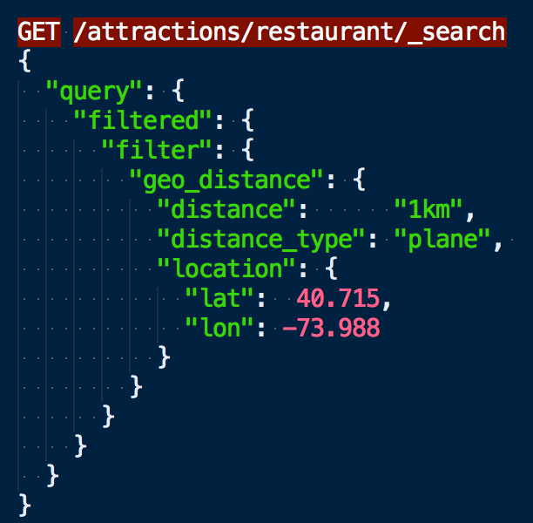
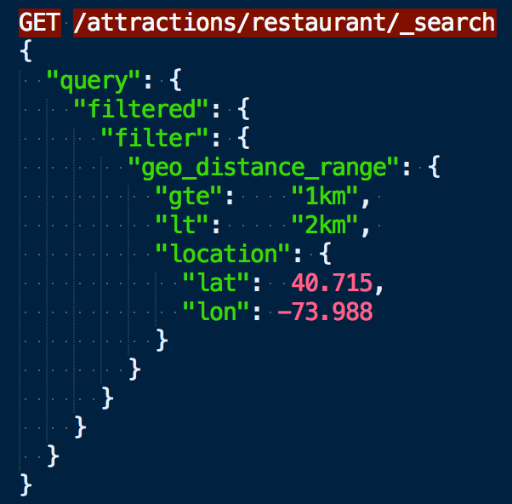
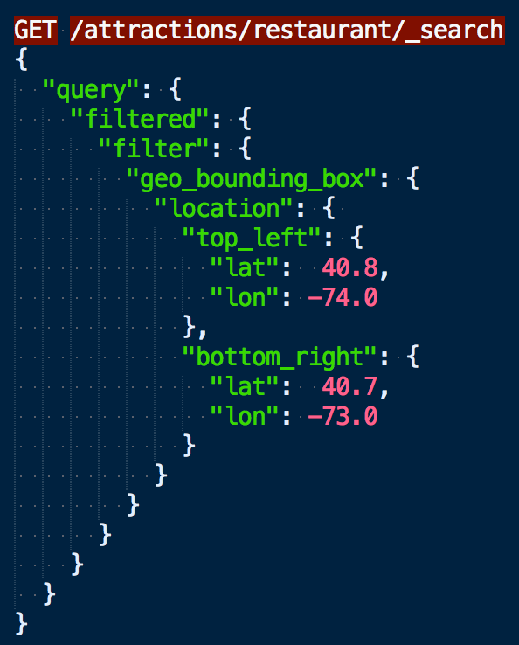
Geospatial search
Filtre par Geo Point
Geo distance, geo distance range et geo bounding box
Notes:
distance_type
How to compute the distance. sloppy_arc (default) arc (slightly more precise but significantly slower) plane (faster, but inaccurate on long distances and close to the poles).

